Slide 1
Determining Sequence Relationships
DNA Barcoding of Life
DNA Subway – Blue Line

Slide 2
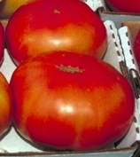
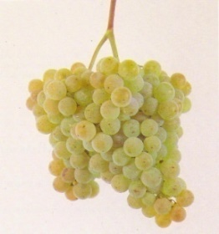
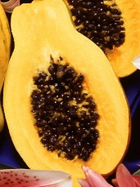
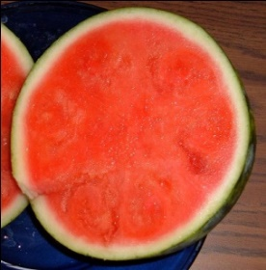
Comparing DNA Sequences
Example: Genetic Testing using BLAST
Reference BRCA1 Sequence
A T A G C T G
Query Sequence(s): Patient 1
A
Look for mutations or changes relative to Reference Sequence
Patient 2
A
C
Patient 3
Example: Multiple Sequence Alignments Using JalView and ClustalW
Papaya
A T G G T G C
Grape
A T G C T G C
Look for changes relative to each other
Tomato
A T G C A G C
Watermelon
A T G G A C A
The amount of change among the sequences reflects
the evolutionary relatedness of the organisms.
Image Source: Wikimedia Commons.
Notes:
Lesson 3 – Slide 4

Slide 3
Pairs of Sequences are Compared to Each Other
Papaya: ATGGTGCCG
Grape: ATGCTGCCG
Grape : ATGCTGCCG
Watermelon: ATGGACACG
Grape : ATGGTGCCG
Tomato: ATGGTGAAG
Papaya : ATGGTGCCG
Tomato: ATGCAGCCG
Tomato : ATGCAGCCG
Watermelon: ATGGACACG
Papaya: ATGGTGCCG
Watermelon: ATGGACACG
Number of Nucleotide Differences:
Papaya Grape Tomato Watermelon
Papaya 0 1 2 3
Grape 1 0 2 4
Tomato 2 2 0 3
Watermelon 3 4 3 0
Image Source: Wikimedia Commons.
Notes:
Lesson 3 – Slide 5

Slide 4
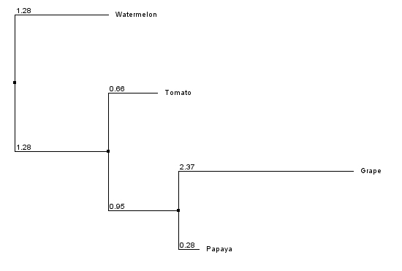
Phylogenetic Trees Reflect Evolution
External Nodes
Internal Nodes
(Common Ancestors)
Image Source: Wikimedia Commons.
Notes:
Lesson 3 – Slide 6

Slide 5
Barcode of Life
https://www.nwabr.org/sites/default/files/iTEST_DNAbarcoding.swf
Animation with audio
Parts 1 & 2
https://www.dnalc.org/resources/animations/dna-barcoding.html
Tutorial (click through animation)

Slide 6
Barcodes of Life
Uses standardized section of DNA to identify species
Use of mitochondrial (mtDNA) or chloroplast (cpDNA)
Found in almost all species (evolutionary conservation)
Enough variation to distinguish between species
~ 8% variation
Little variation within species
~0.4% variation
Animals: mtDNA CO1 gene
Flowering Plants: cpDNA rbcL gene
Also matK
Fungus: ITS (nuclear internal transcribed spacer)
Notes:
ITS variable region that surrounds the 5.8s ribosome RNA gene

Slide 7
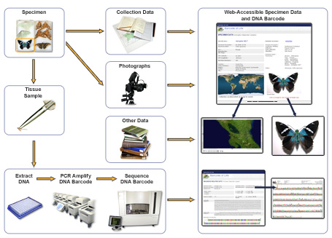
Barcode of Life process
Source: http://www.ibol.org/about-us/what-is-dna-barcoding/

Slide 8
Use of Barcode of Life
Expanding the record of known species
GenBank database
Identify invasive species of plants or animals
Uncover consumer fraud
Tracking spread/source of disease in public health
Environmental monitoring
Evolutionary record

Slide 9
DNA Subway - easy access to high-performance computing.
- Pipelines combine many computation tools without requiring specialized computer programing expertise
- Produces scientifically valid results
One Minute Video https://www.youtube.com/watch?v=Ppufj9Ji4Fc&index=1&list=PL-0S9LiUi0vhhck1OiSFK6jJznCjWhgqt
Notes:
Use DNA Subway to complete a DNA barcoding workflow that would normally require several independent software and web applications.

Slide 10
DNA Subway - Blue Line
http://dnasubway.iplantcollaborative.org/
Practice with rbcL sample 1

Slide 11
DNA Subway - Blue Line
To analyze DNA barcodes and build gene trees
1. Use sequenced data in FASTA data format
Evaluates sequence data for quality & trims low quality ends.
Checks for any discrepancies in the sequence
Allows comparison to sequences from other organisms using BLASTn
Multiple alignment to other sequences (MUSCLE)
Makes phylogenetic trees to show relationships between the organisms

Slide 12
Sequence Alignment
Compare sequences
% identity – how many characters (e.g. nucleotides or amino acids) are the same
E = probability value, want 20 or higher
Phred score: rates quality of sequence data for each nucleotide
Based on exponents: Lower score the better.
E = 10 (90% probable)
E = 20 (99.9% probable)
E = 30 (99.99% probable)
Notes:
High % identity implies common biological function or evolutionary connection. Want % identity ≥70% for nucleotides; ≥ 25% for proteins.

Slide 13
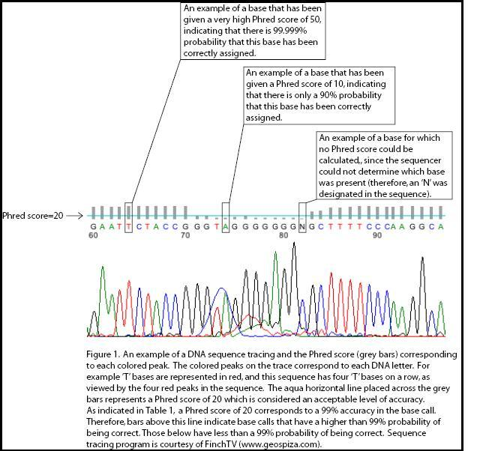

Slide 14
Neighbor Joining Phylogenetic tree
Based on comparison of DNA or protein sequence data
Evolutionary related = homologous
Align sequences & compare
Mutation differences
Single nucleotide polymorphisms (SNP)
Insertions or deletions (Indels)
Notes:
Computer programs used to align sequences – by trying to maximize the number of matches by changing the positions and/or finding gaps

Slide 15
Maximum Likelihood Phylogenetic Tree

Slide 16
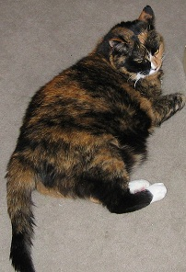
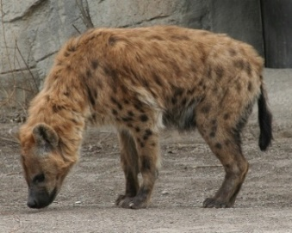
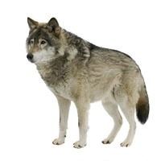
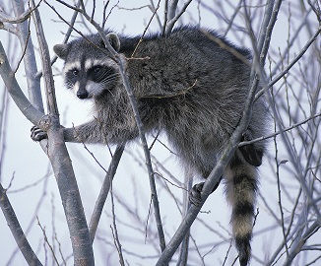
Phylogenetic Trees: The Carnivores Relatedness of Major Carnivores
Domestic Cat
Felis catus
Cats
Cat Branch
Civets
Mongooses
Hyenas
Spotted Hyena
Crocuta crocuta
Canids
Internal Nodes
(Common Ancestors)
Bears
Dog/Bear Branch
Red Pandas
Skunks
Gray Wolf
Canis lupus
Weasels
Raccoons
Seals
Fur Seals
Sea Lions
Raccoon
Procyon lotor
Walruses
Adapted from : “WhoZoo: Images and Information about Animals at the Fort Worth Zoo.” http://www.whozoo.org/mammals/Carnivores/carnivorephylogeny.htm. Developed in part from mitochondrial sequence data from Arnason, et al. Mammalian mitogenomic relationships and the root of the eutherian tree. PNAS 99 (June 11, 2002): 8151-8156.
Images Source includes Wikimedia Commons.
Notes:
Lesson 3 – Slide 7

Slide 17
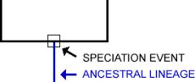
Phylogenetic Tree
Shows evolutionary relationship of groups of organisms
(http://evolution.berkeley.edu).

Slide 18
Blue Line Demonstration
Demonstration (8 minutes)
https://www.youtube.com/watch?v=7WF--Ba2P10

